Slide 1
SWOP Iteration 1 Group 03
Kwinten Buytaert
Mathias Dekempeneer
Vincent Derkinderen
Ben Goethuys

Slide 2
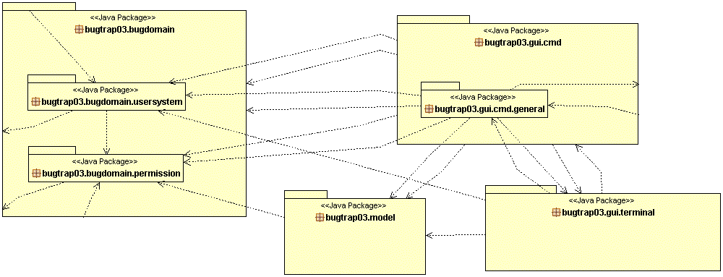
Overview Package level
Notes:
M
Notice: no dependencies from BugDomain to others.
Notice: No dependencies from Model to UI.
=> Low coupling

Slide 3
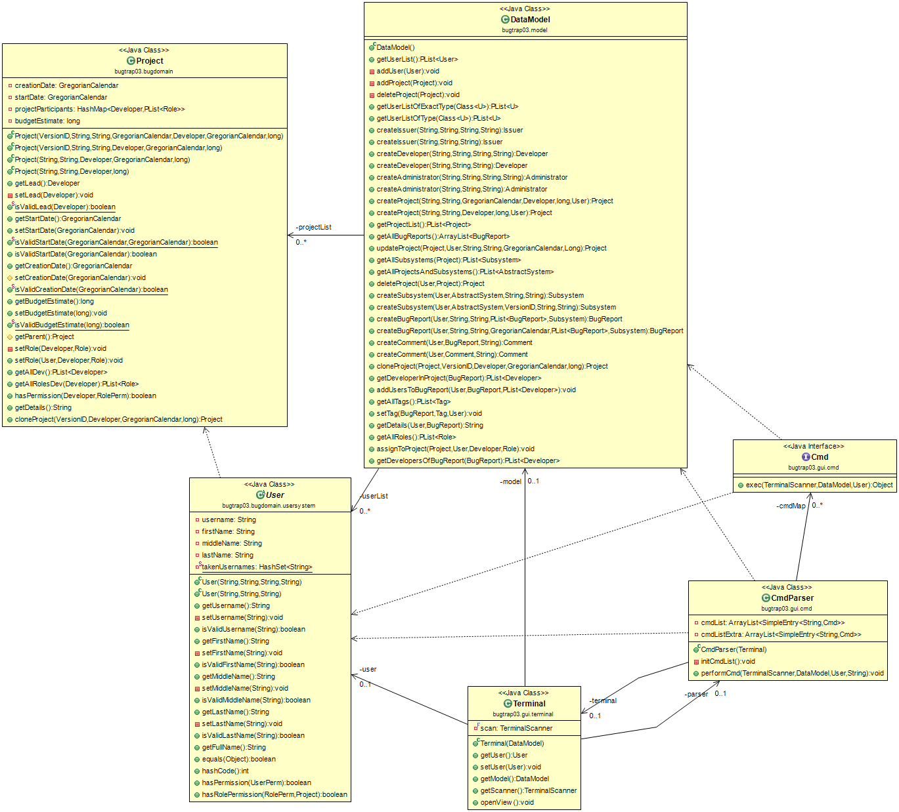
Overview (Class level)
Notes:
M
General overview of the more important classes involved in the interaction between the packages.
Project, Datamodel, User, Terminal, CmdParser, Cmd
Notice: no dependencies from BugDomain to others.
Notice: No dependencies from Model to UI.

Slide 4
Bug domain
Notes:
K
Next we will have a look at the bugdomain package.

Slide 5
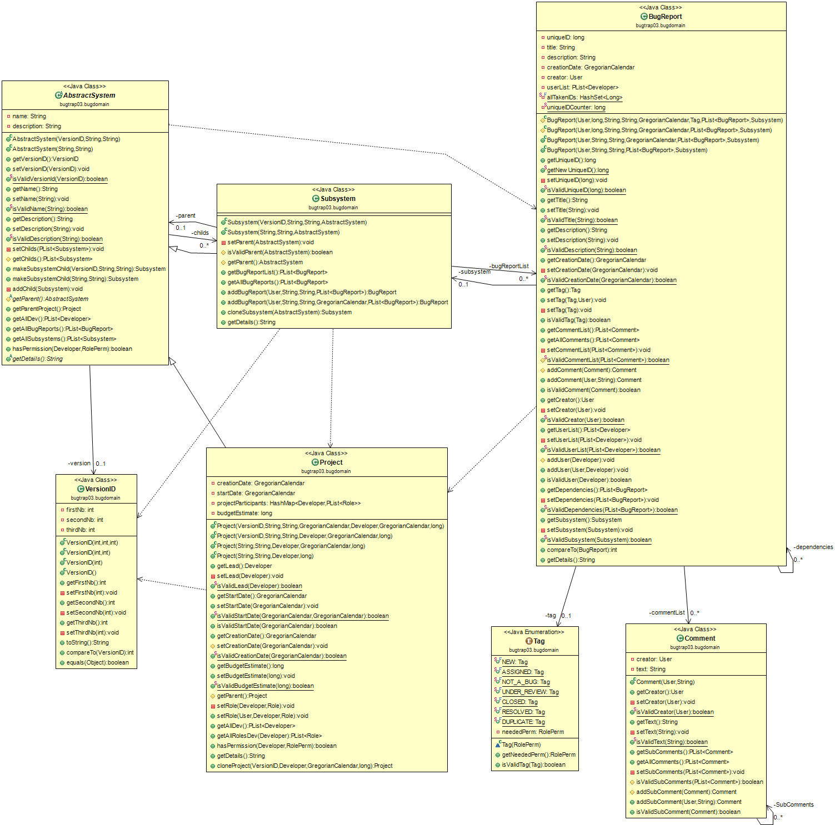
bugdomain
Notes:
K
Project + Subsystems
* AbstractSystem (name, vID, descip, childs). Proj & Sub inherits.
+ Polymorhispm
+ High Cohesion
+ creator principle (constructor of subsystem not in API, but from abstract system)
- High Coupling
* Project w attribute SubSystem.
- Code redundancy;
- High Coupling (Lower than first)
* Project & Subsystem as one class (Composite)
+ Low Coupling
- Low Cohesion (Can't differentiate between Proj & Sub. Code for Bugreports is redundant for Proj)
BugReport + Tags (Duplicate specifiek)
* Tag enum w logic inside the Tag enum.
+ Information Expert
+ High Cohesion
* Tags als objecten w logic inside the Tag
+ Polymorhispm -> seperate the logic inside the Tags
- High coupling between Tag Objects
+ Option to add non-static variables.

Slide 6
Project,BugReport, User & permissions
Notes:
B

Slide 7
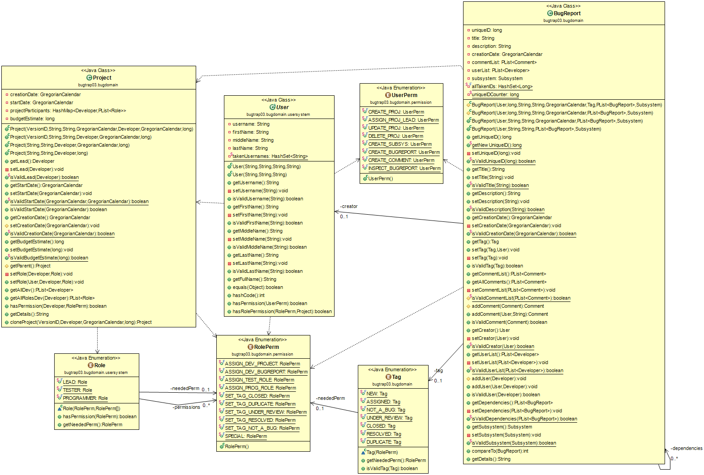
Project,BugReport, User & permissions
Notes:
B
Shows Permissions interaction
Also mention the User, Dev, Admin, Issuer hierarchie.
User + Project + Role + RolePerm
* Project holding list of Users with roles. And associate list of rolePerms with Role
- High Coupling (to RolePerms; no interface of methods such as
+ Information Expert
* RolePerms = classes held in user
- Low cohesion
+ Information Expert
* PermissionManager - see User hierarchie + Userperm
User hierarchie + UserPerm
* UserPerm as enum and User hierarchie has arrays of the permissions the user has
+ Polymorpishm (also very flexibile can be changed dynamic)
+ High Cohesion
+ Information Expert
- High Coupling between 2 classes (A lot of coupling w permissions since User does not define methods for each permission, rather there are permissions for every action and it is checked if the user has this.)
- High Coupling between User & Permissions (Adding a permission requires an update for the user hierarchie to make sure certain users have the permissions and others do not.)
* User class + Enum userType + Using UserPerm as argument of userType
- Low Cohesion (Hard to enforce User type as parameter etc + instanceof hierarchie not possible)
- High coupling
- No Polymorpishm
+ Information Expert
* PermissionManager holding Permissions for each user with Permissions as Objects.
- High Coupling (need reference to this to check permissions)
+ High Cohesion
+ Pure Fabrication ('outsource' responsibility)
+ Polymorpishm (allow this; but isn't used)
- Polymorpishm (Lot of overhead; Big hierarchie of permissions)

Slide 8
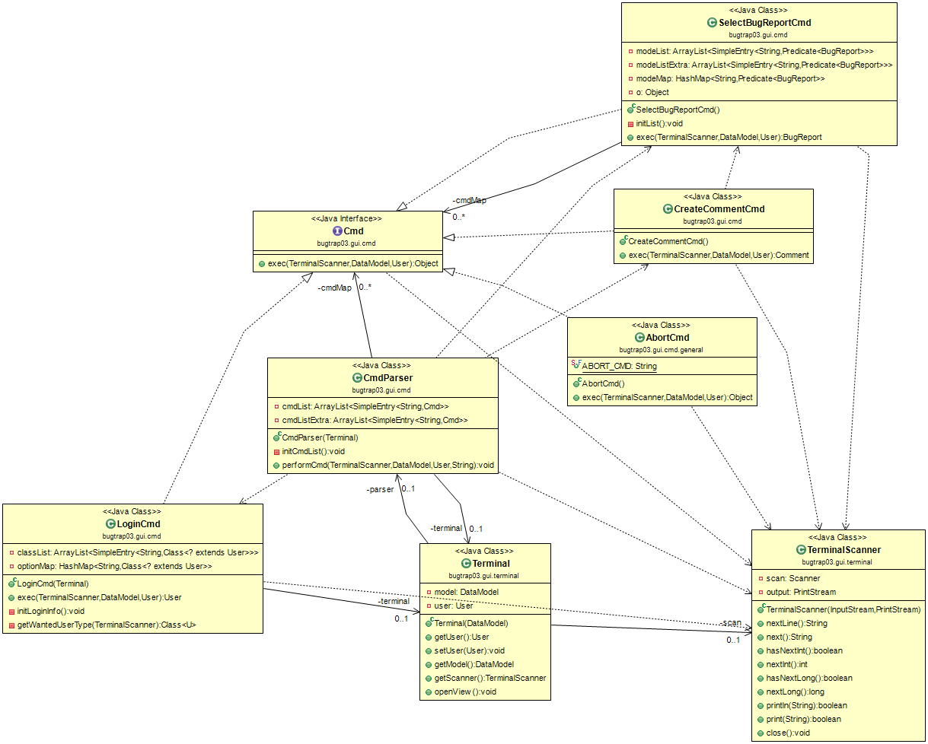
Commands - UI
Notes:
V
Explain Scenario’s; Interaction from UI and How DataModel fits in.
UI - Model - Cmd
* Seperate Use case steps into Cmds
+ Low coupling
- High cohesion
+ Controller
+ Polymorphispm (little bit - Cmds)
* Methods lots of methods
+ High coupling
- Low cohesion

Slide 9
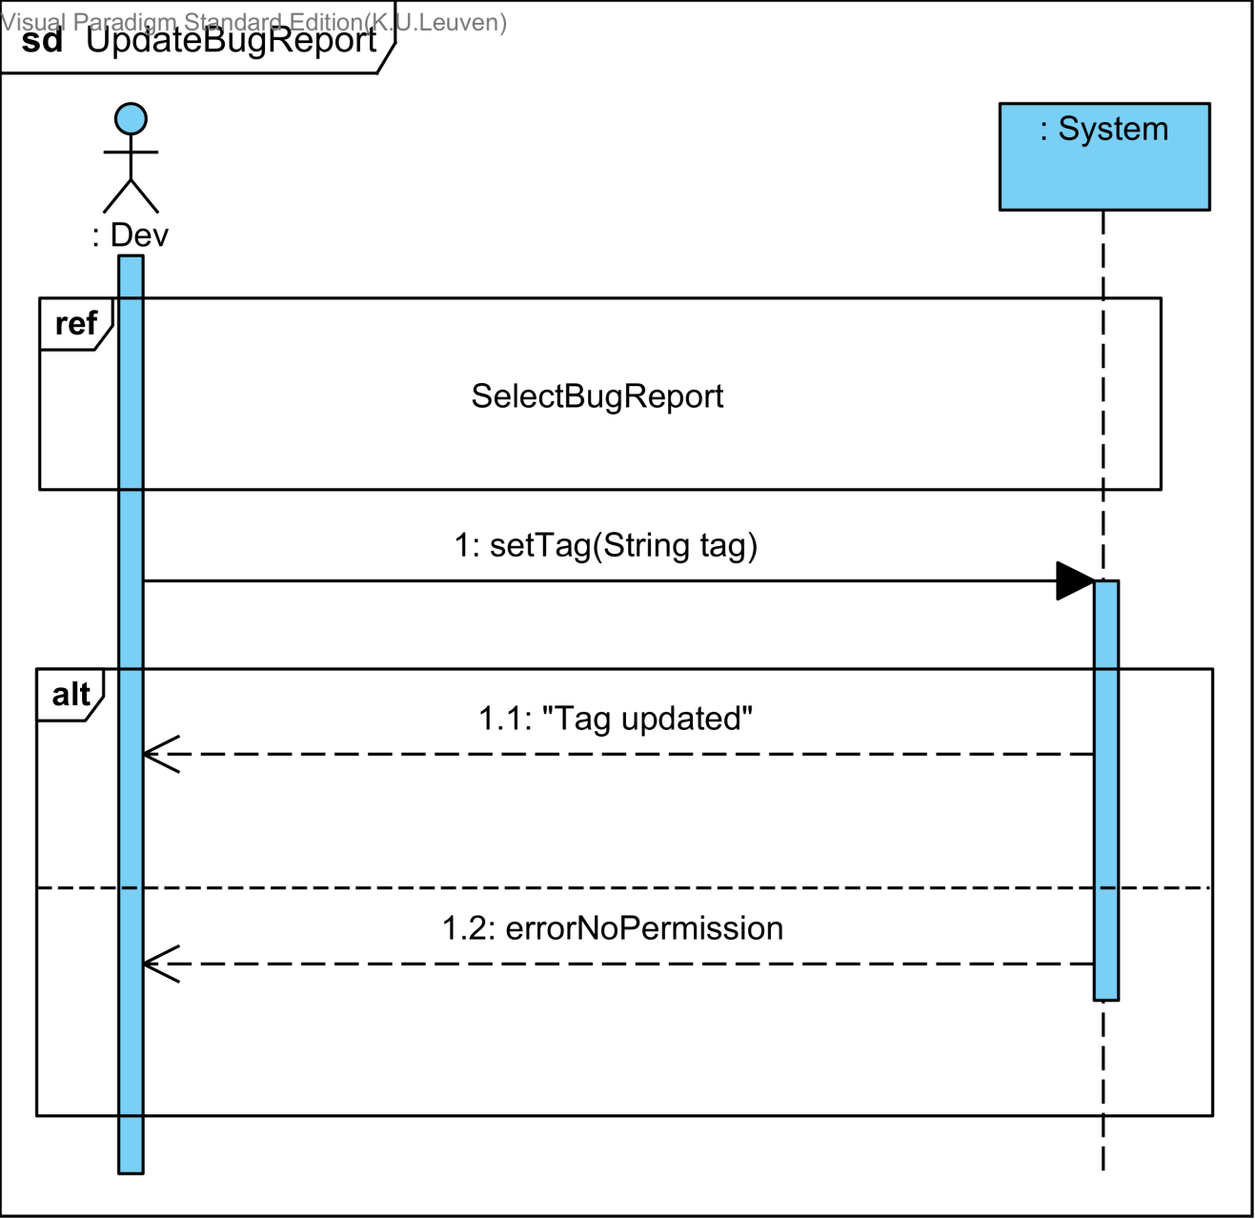
Use case e.g UpdateBugReport
Notes:
V
System sequence diagram

Slide 10
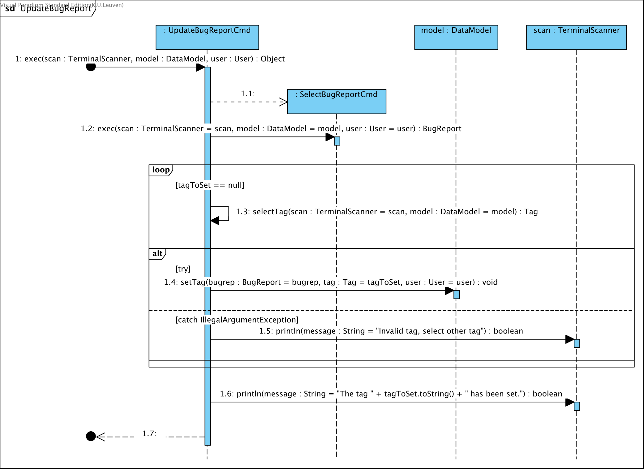
Detailed use case
Notes:
V
Sequence diagram

Slide 11
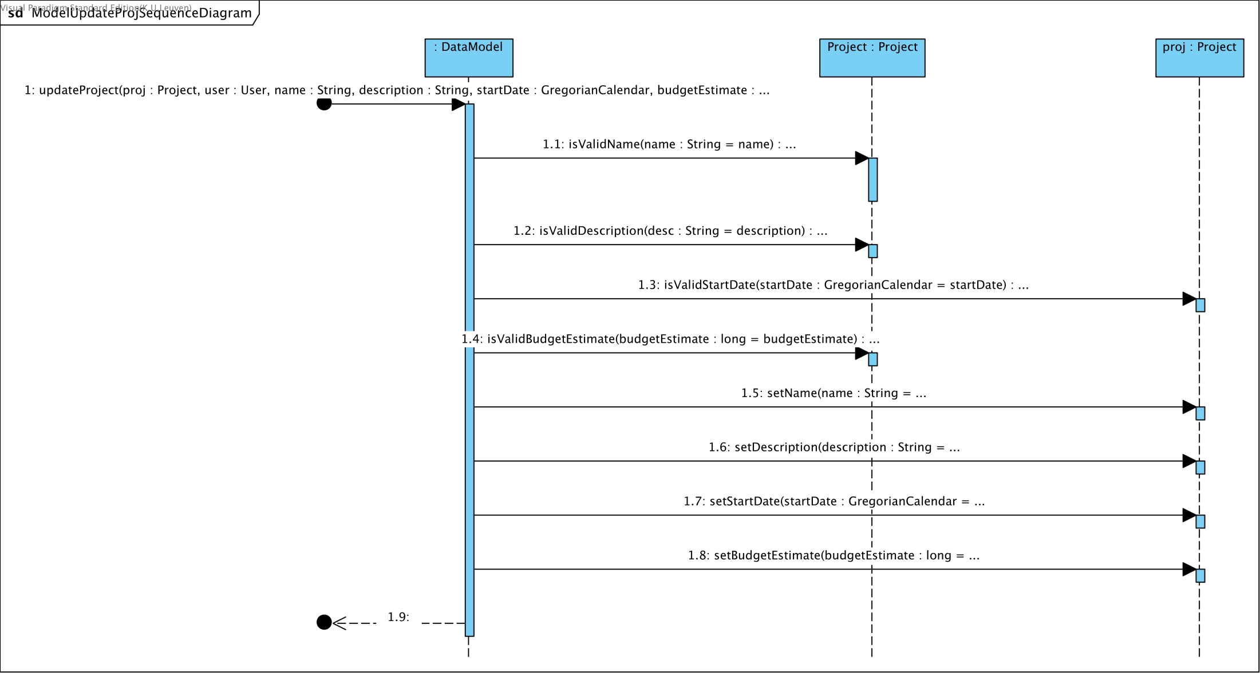
DataModel UpdateProjectSequence

Slide 12
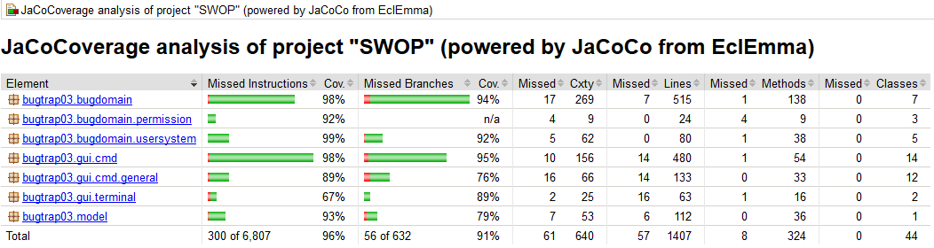
Test Coverage
Notes:
K /
TODO? Tekstvak met uitleg Test strategy? (White box testing + stubbing)

Slide 13
TimeTable
iteration | 1 | 2 | 3
ben | 109:50
vincent | 107:05
mathias | 73:45
kwinten | 62:15
In h:mm
Roles
Design Coordinator - Derkinderen Vincent
Testing Coordinator - Buytaert Kwinten
Domain Coordinator - Dekempeneer Mathias

Slide 14
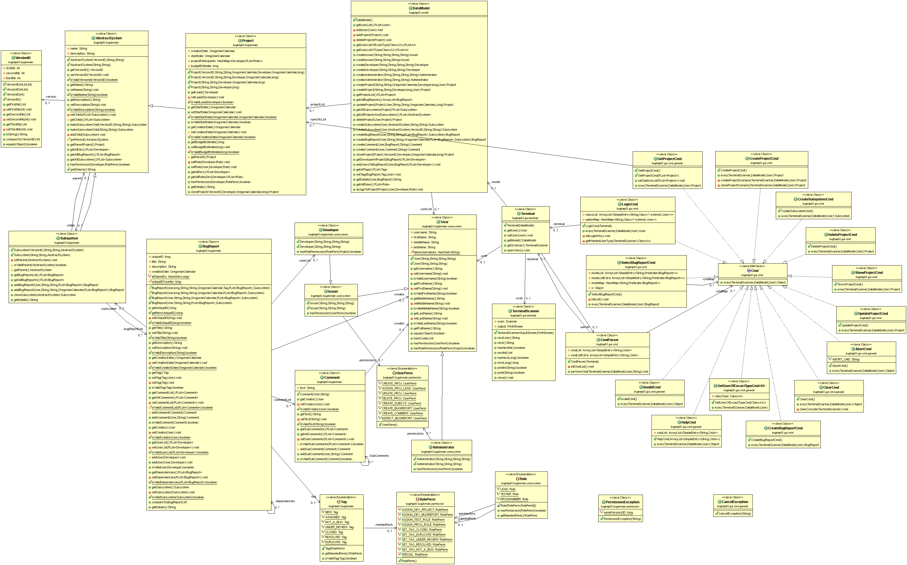
Notes:
Hide – Backup/Just in case
Side Information GRASP:
High cohesion
Low coupling
Information expert
Don't talk to strangers
Polymorpishm
Controller
Pure Fabrication (Not in conceptual model, specifically made for code)
Protected Variation (Assigning responsibility in a way that variations do not have undesirable effects. The way to build a stable 'interface' in a context of variations.)
Indirection (outsource responsibility)

